Slide 1
Week 1 Discussion
Loni Taylor
06/04/2025

Slide 2
weather, climate, animal behavior: Wiki definitions
Weather is the state of the atmosphere, describing for example the degree to which it is hot or cold, wet or dry, calm or stormy, clear or cloudy.
Climate is the long-term weather pattern in a region, typically averaged over 30 years.
Animal behavior describes all the ways animals interact with their environment and with each other, including physical movements, vocalizations, and mental processes.

Slide 3
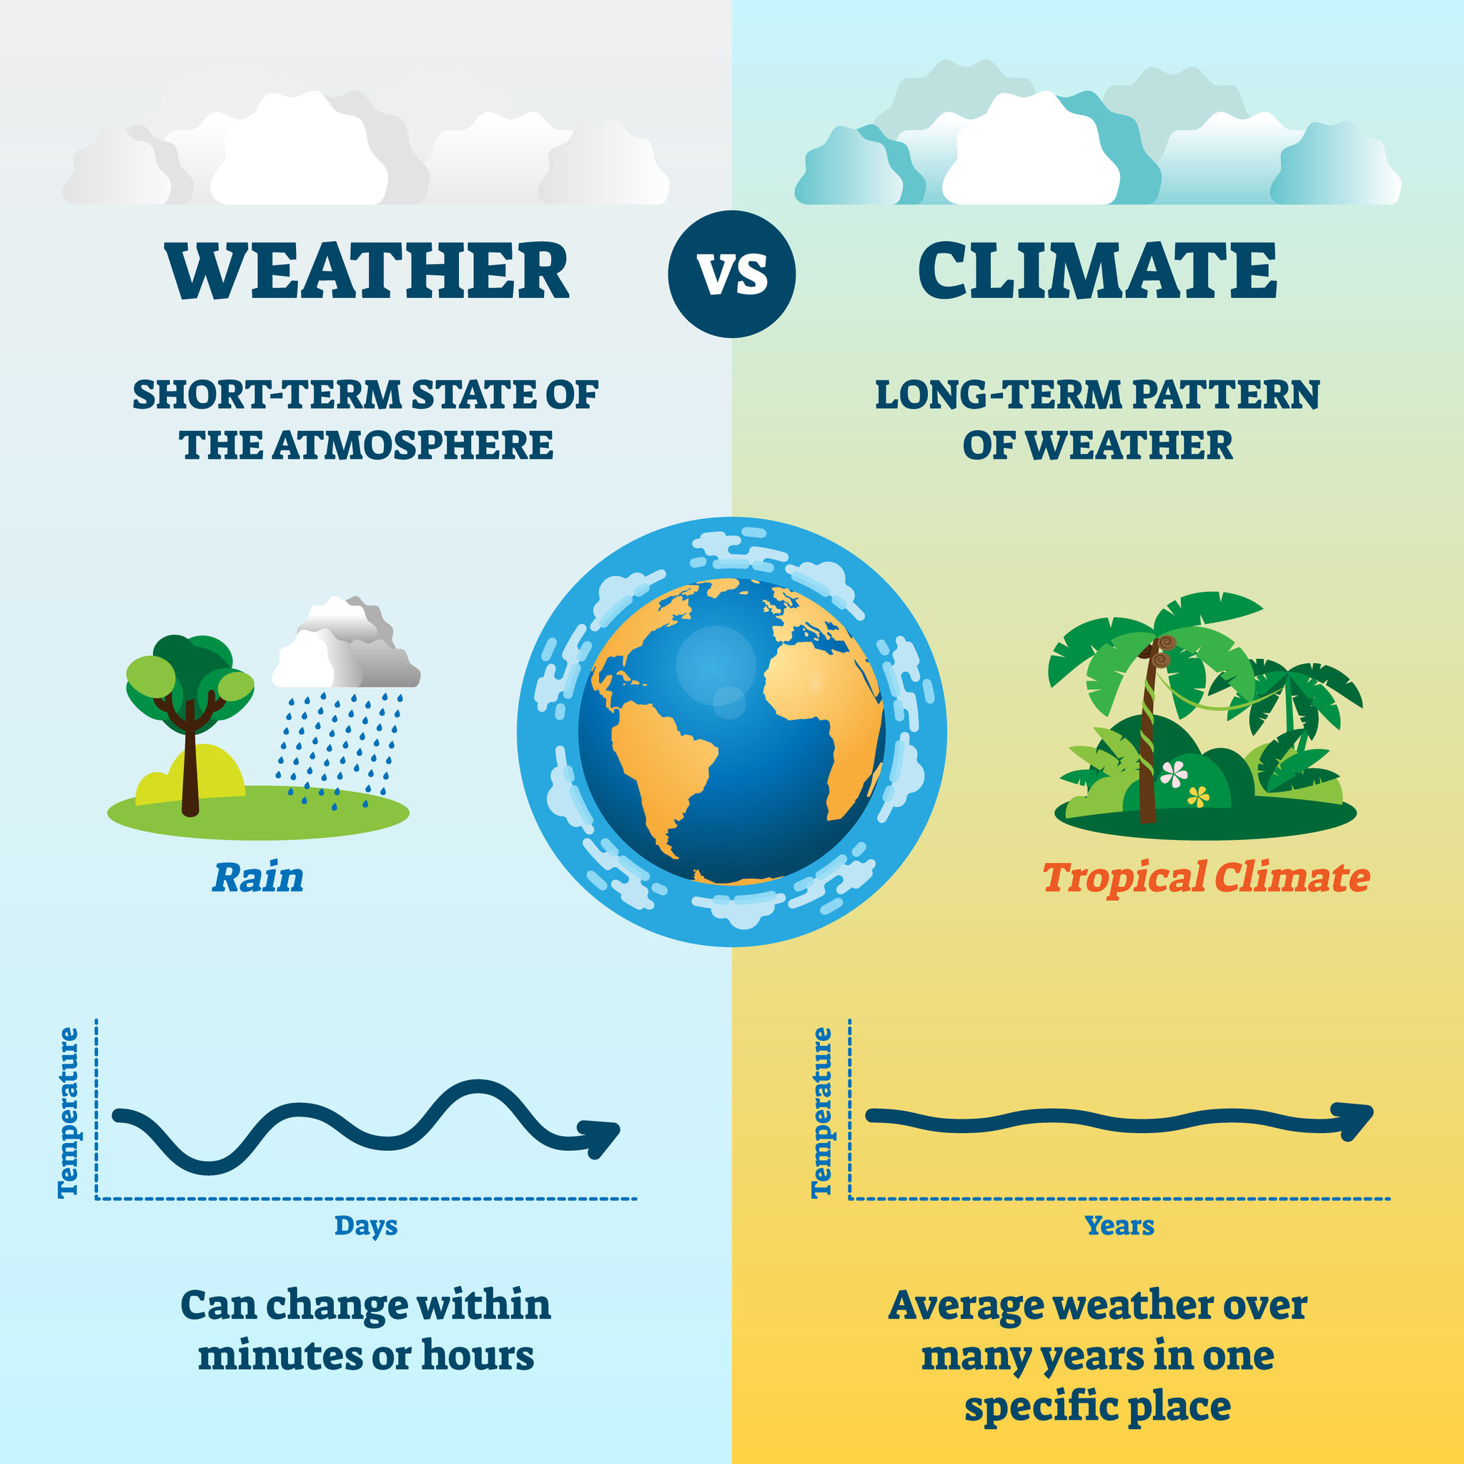
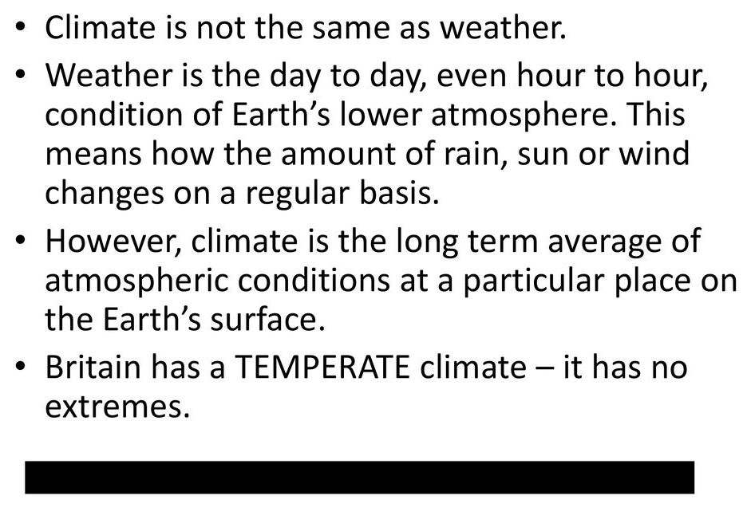

Slide 4
ecology and ecosystems : Wiki definitions
Ecology is the natural science of the relationships among living organisms and their environment.
Focuses on how animals interact with their environment and how their behavior is shaped by ecological factors
An ecosystem is a system formed by organisms in interaction with their environment.
ecosystem is a geographic area where living things (biotic factors) interact with each other and with their non-living environment (abiotic factors). These interactions create a complex web of life, where energy and matter are exchanged within the system.

Slide 5
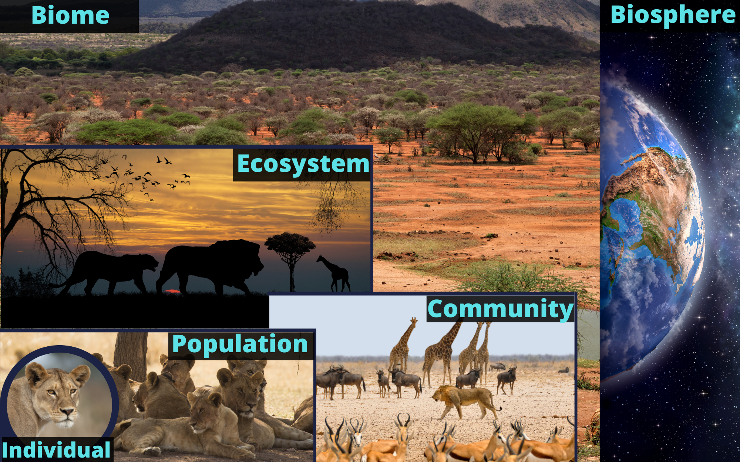

Slide 6
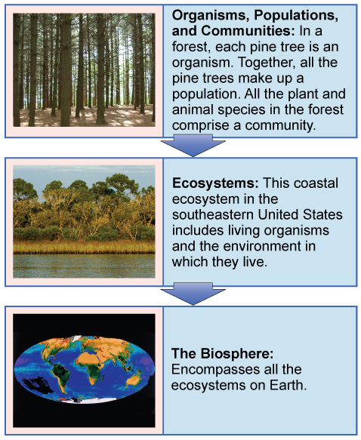

Slide 7
weather and climate in ecosystems: discussion

Slide 8
weather and climate in ecosystems: discussion
Changes in the components of the climate system, such as the Sun's energy, atmospheric composition, or land cover, can lead to overall climate changes.
significantly impact ecosystems by influencing plant growth, animal behavior, and the overall functioning of ecosystems.
Factors like temperature and precipitation directly influence the types of plants that can grow, which in turn dictates the availability of food and shelter for animals. Climate also affects animal behavior, such as migration patterns and nesting times, and can even impact the timing of natural processes like flower blooms.

Slide 9
weather and climate in ecosystems: discussion
Changes in climate can lead to more frequent or intense weather events, which in turn can disrupt ecosystems.
Species with narrow tolerance ranges to environmental conditions may be particularly vulnerable to changes in weather and climate.

Slide 10
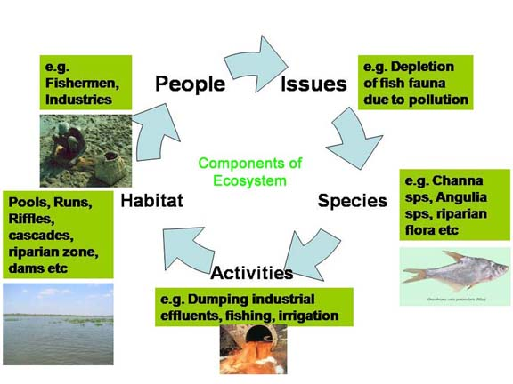
weather and climate in ecosystems

Slide 11
Images source from google media Definitions sourced from wiki

